Slide 1
BASE PAPER TITLE::DETECTION ENHANCEMENT FOR VARIOUS DEEPFAKE TYPES BASED ON RESIDUAL NOISE AND MANIPULATION TRACES
OWN TITLE::DETECTION OF DEEP FAKE FORENSICS

Slide 2
ABSTRACT
As deep fake techniques become more sophisticated, the demand for fake facial image detection continues to increase.
Various deep fake detection techniques have been introduced but detecting all types of deep fake images with a single model remains challenging.
We propose a technique for detecting various types of deep fake images using three common traces generated by deep fakes: residual noise, warping artifacts, and blur effects.
We adopted a network designed for steganalysis to detect pixel-wise residual-noise traces. We also consider landmarks, which are the primary parts of the face where unnatural deformations often occur in deep fake images, to capture high-level features.
Finally, because the effect of a deep fake is similar to that of blurring, we apply features from various image quality measurement tools that can capture traces of blurring.
The results demonstrate that each detection strategy is efficient, and that the performance of the proposed network is stable
and superior to that of existing detection networks on datasets of various deep fake types.

Slide 3
SCOPE
This project in image forensics of general image modifications, several deep fake detection techniques have been proposed.
This used color mismatch in two eyes and noise owing to inaccurate geometric predictions and inaccurate light predictions.
Deep fake using the inconsistency in the 2d direction between the narrow face area and overall head.
The proposed two simple fake-face detection networks that exploit macroscopic features. Because training is performed with a distribution in the RGB color space, changed the color space to HSV and detected deepfake using the statistical difference between the color spaces.

Slide 4
OBJECTIVES
We propose a technique for detecting various types of deep fake images using three common traces generated by deep fakes: residual noise, warping artifacts, and blur effects.
We adopted a network designed for steganalysis to detect pixel-wise residual-noise traces.
We also consider landmarks, which are the primary parts of the face where unnatural deformations often occur in deep fake
images, to capture high-level features.
Finally, we apply features from various image quality measurement tools that can capture traces of blurring.

Slide 5
EXISTING SYSTEM
This project is present a preview of deep fake detection challenges public a dataset and feature two facial modification algorithms.
In states the challenges and opportunities of fake news and detecting fake news by proposing algorithms which detect fake
news form the web services.
This survey provides a comprehensive review of the recent developments on deep face recognition that covers databases and protocols, algorithm designs, and application scenes.
This paper presents a review of face image manipulation techniques, deep fake methods, and methods to detect manipulations.
Deep fake, a deep learning based technology, to alter images and videos. In most cases images and videos are used as evidence in investigations and court; but, deep fake has potentially made these pieces of evidence unreliable.
This research examines its origin and history while assessing how deep fake photos videos are created and present deep fake impacts on society.

Slide 6
DISADVANTAGES
Creating fake news and propaganda deep fake is majority used for revenge.
Fake videos goes viral people believe initially, and keep sharing with others makes the targeted person.
Privacy problems.

Slide 7
PROPOSED SYSTEM
In this study, we proposed a generalized detection method to detect three types of deep fake techniques: face swap, puppet-master, and attribute change.
We exploited three types of common traces residual noise, warping artifacts, and blur effects generated by the deep fake process. We
applied them to the proposed network for deep fake detection.
First, a network designed for steganalysis was adopted as the base network to detect residual noise. Second, landmark patches were extracted from the semantic facial region to detect warping artifacts, which are unnatural high-level features.
Finally, we applied IQM features to capture the statistical characteristics of the blur-like effects of a deep fake.
The results revealed that each detection strategy is effective, and the performance of the proposed network is superior to that of existing networks.
Because a deep fake video inherits residual features from image operations, our approach can be directly adopted for deep fake video
detection pipelines based on frame-by-frame detection.
Based on the proposed method, we plan to expand this study to include a deep fake video detection method. We hope this method is robust against signal- and time-based attacks.

Slide 8
ADVANTAGES
We propose a generalized detection method using traces to detect three types of deep fake: face swap, puppet master, and attribute change.
We developed a network based on image quality measurement (IQM) features and warping artifacts extracted from facial landmarks.
We propose using a network designed for steganalysis to capture residual noise traces in deep fake images.

Slide 9
H/W SYSTEM CONFIGURATION:
PROCESSOR
RAM
HARD DISK
- I3, I5, I7, AMD Processor
- Above 6 Gb
- Above 500 GB

Slide 10
S/W SYSTEM CONFIGURATION:
OPERATING SYSTEM
FRONT END
- Windows 8/10
- HTML ,CSS
NOTEBOOK
IDLE
- Anaconda(Jupiter)
- Python(3.10)

Slide 11
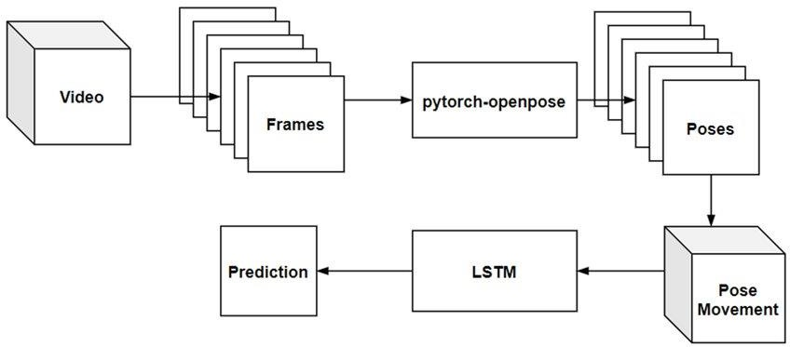
BLOCK DIAGRAM:

Slide 12
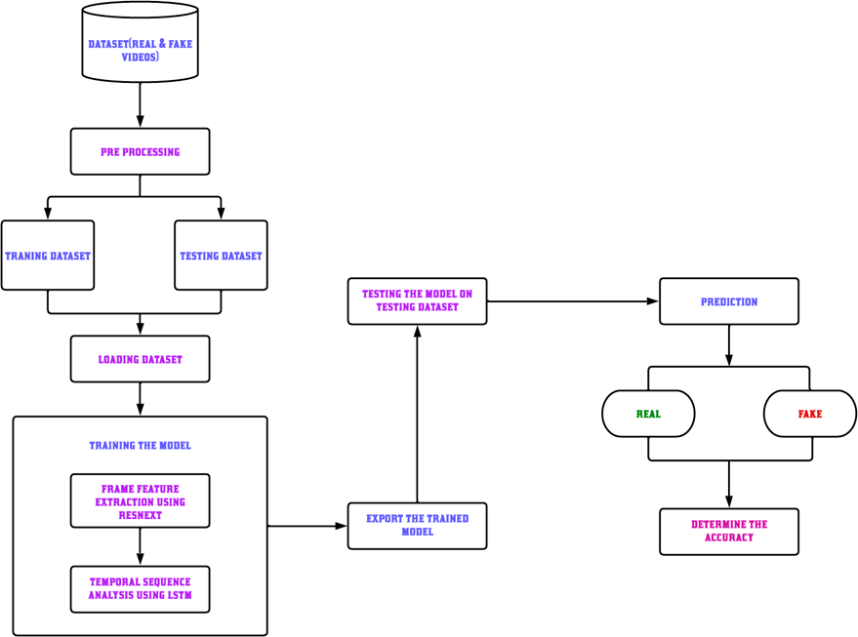
DIAGRAM

Slide 13
Experimental Setup
To test the proposed hypothesis that body languages can identify and expose deepfakes, a many-to-one LSTM model was designed using PyTorch. PyTorch provides flexible DNN implementation and GPU support. Two kinds of objects are necessary for setting up the training and testing experiment: (a) the object for data loading and (b) the object for model creation. The custom dataset was divided into an 80% training set, a 10% validation set, and a 10% testing set. Moreover, the values were normalized to the range. A specially designed (according to needs of our custom dataset) Data Loader that was used for passing the datasets to the LSTM model for training. The data only contain the body languages with 24 key points, the model to be implemented with a binary classification model having an input layer with 24 features. It also contains a fully connected output layer with a single output unit. The many-to-one LSTM model outputs the prediction at the last time step. It is observed that every 150 poses are a continuous movement; therefore, the time step of the model is 150. The hidden size and the number of hidden layers should be decided based on the experiment. The proper depth and width of the network can prevent under fitting and over fitting problems. The initial setup was based on the original LSTM architecture, which only has a single hidden layer. A single hidden layer cannot be followed by a dropout layer, so that the initial dropout was zero

Slide 14
CONCLUSION
This project is used as a deep fake creation, and detection methods. Deep fake creates forged images or videos that persons
cannot differentiate from real images or videos.
Deep fakes are created using generative adversarial networks, in which two machine learning models exit.
One model trains on a dataset and the other model tries to detect the deep fakes. The forger creates fakes until the other model can't detect the forgery.
Deep fakes creating fake news, videos, images, and terrorism events that can cause social and financial fraud. It is increasing affects religions, organizations, individuals and communities', culture, security, and democracy.
When deep fake videos and images increase on social media people will ignore to trust the truth.
So, deep fake datasets and cross-platform detection techniques need to be developed in the future. This needs efficient, reliable and robust mobile detectors to detect deep fakes in widely used mobile devices.
Moreover, will improve deep fake detection by integrating deep fake detection and object detection algorithms.

Slide 15
Thank you….

